Slide 1

Climate Change and
Technology: A Path to Sustainability
Climate change is one of the greatest challenges facing humanity. Rising global temperatures, increased extreme weather events, and disrupted ecosystems are stark reminders of the urgency to act. Technological innovation is crucial to addressing this crisis. Climate tech, a rapidly developing field, offers a pathway towards a sustainable future.
by Md Mubin

Slide 2


The Rise of Climate Tech
1
2020-2023: Exponential Growth
Climate tech investments have skyrocketed in recent years, fueled by rising awareness, government support, and the decreasing cost of renewable energy.
2
Renewable Energy Dominates
Solar and wind power lead the charge in climate tech investments, thanks to their affordability and ability to scale.
3
Emerging Technologies Gain Attraction
Investments in hydrogen energy, long-duration energy storage, and direct air capture are on the rise, promising to revolutionize decarbonization efforts.

Slide 3
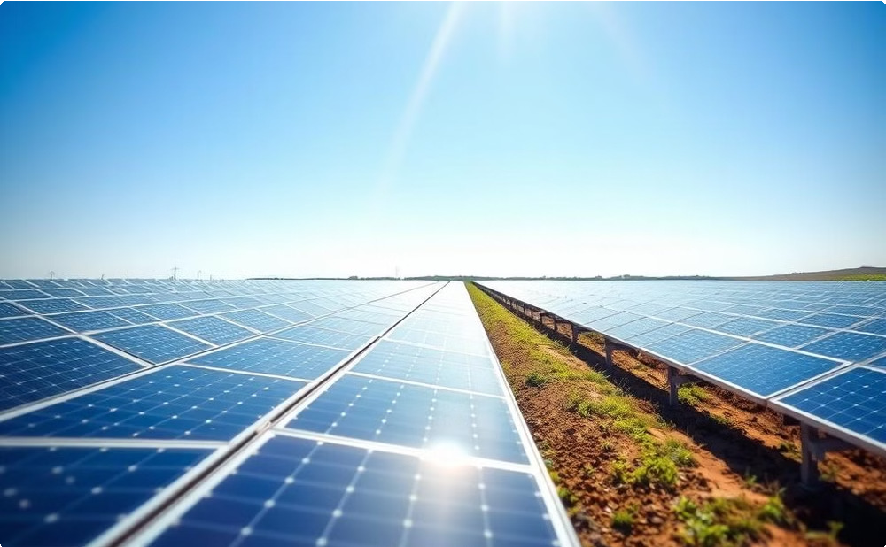


Renewable Energy: Powering the Future
Solar Power: A Global Boom
Solar energy deployment is rapidly expanding worldwide. Advances in solar panel efficiency and cost reductions are driving this growth.
Wind Power: A Reliable Source
Wind power continues to be a critical component of the renewable energy transition, with improvements in turbine design and grid integration.
Hydropower: A Maturing Technology
Hydropower remains a significant source of renewable energy, with ongoing projects to expand capacity and improve efficiency.

Slide 4

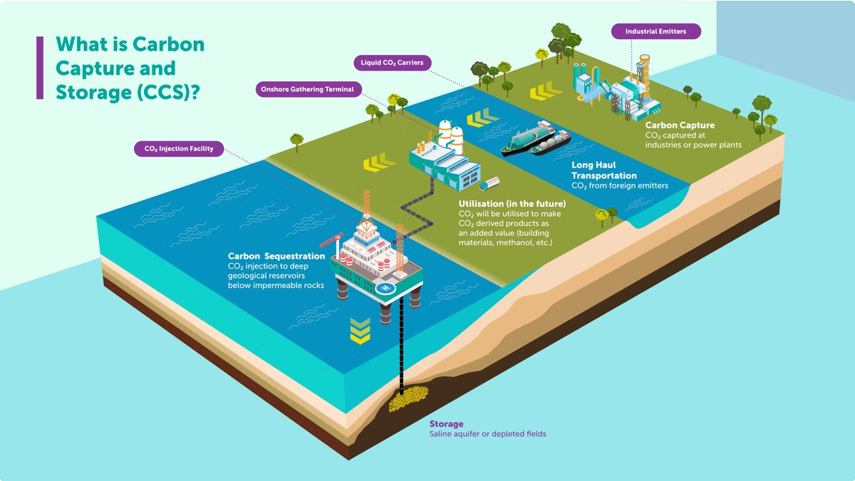
Carbon Capture and Storage (CCS): Bridging the Gap
Storage and Sequestration
Captured CO2 is stored underground in geological formations or converted into valuable products.
Capturing CO2
CCS technologies capture carbon dioxide emissions from industrial processes, power plants, and other sources.
Enabling Negative Emissions
Bioenergy with carbon capture and storage (BECCS) can remove CO2 from the atmosphere, potentially achieving net-negative emissions.

Slide 5

AI and Big Data for Climate Management
1
Predictive Analytics
AI algorithms analyze climate data to predict weather patterns, identify climate risks, and inform policy decisions.
Resource Optimization
AI-powered systems optimize renewable energy grid management, enhance energy efficiency, and support sustainable agriculture.
2
3
Data-Driven Insights
Big data analytics provide insights into climate trends, emissions sources, and the effectiveness of climate mitigation strategies.

Slide 6

Sustainable Materials and Smart Infrastructure
Eco-Friendly Construction
Innovations in building materials, such as carbon-neutral
1
concrete and biodegradable plastics, reduce the environmental footprint of construction.
Smart City Technologies
IoT-enabled infrastructure, data-driven resource management, and smart grids enhance energy efficiency and sustainability in urban environments.
2
Integrated Systems
Combining sustainable materials, smart technologies, and renewable energy sources creates resilient and environmentally responsible urban ecosystems.
3

Slide 7

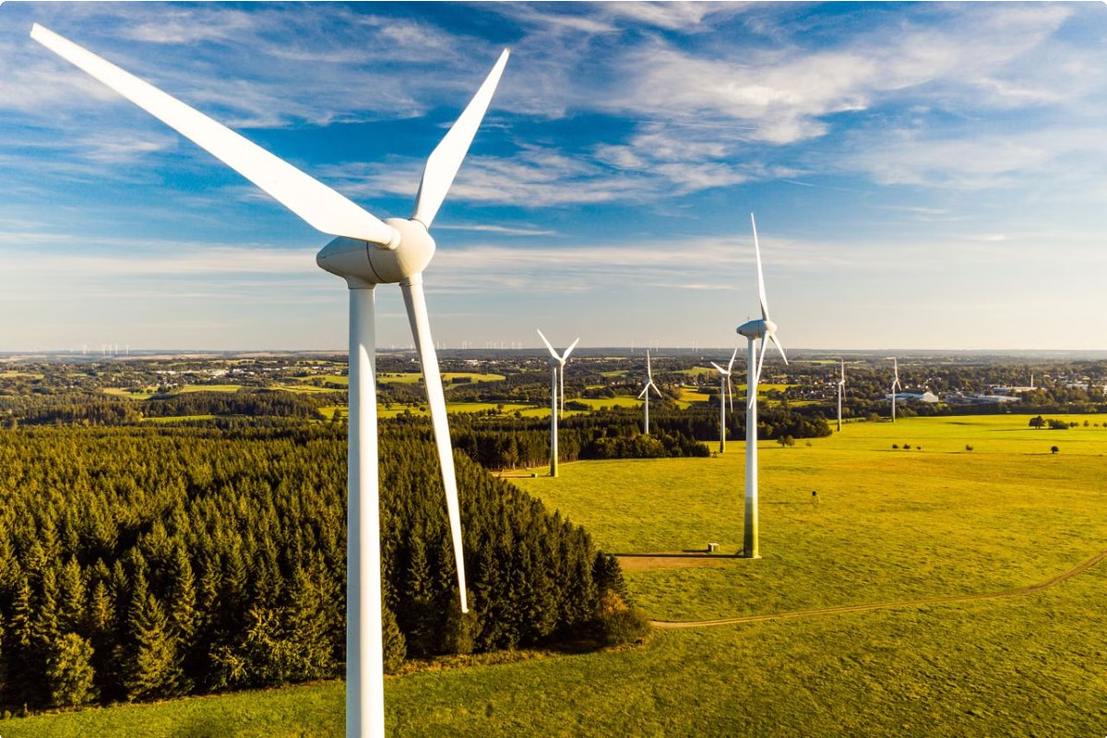
Case Study: Denmark's Wind Energy Leadership
Year | Wind Power Share | Total Renewable
 | (%) | Energy Share (%)
2010 | 25 | 45
2015 | 35 | 55
2020 | 40 | 65
2025 (Target) | 50+ | 70+
Key drivers of Denmark's wind energy leadership:
Government policies: Carbon taxes, feed-in tariffs, R&D funding
Public-private partnerships: Collaboration between utilities, manufacturers, and research institutions
Technological advancements: Improved turbine design, manufacturing processes, and grid integration
Wind power: Denmark has become a global leader in wind energy technology, with a strong emphasis on offshore wind farms.

Slide 8

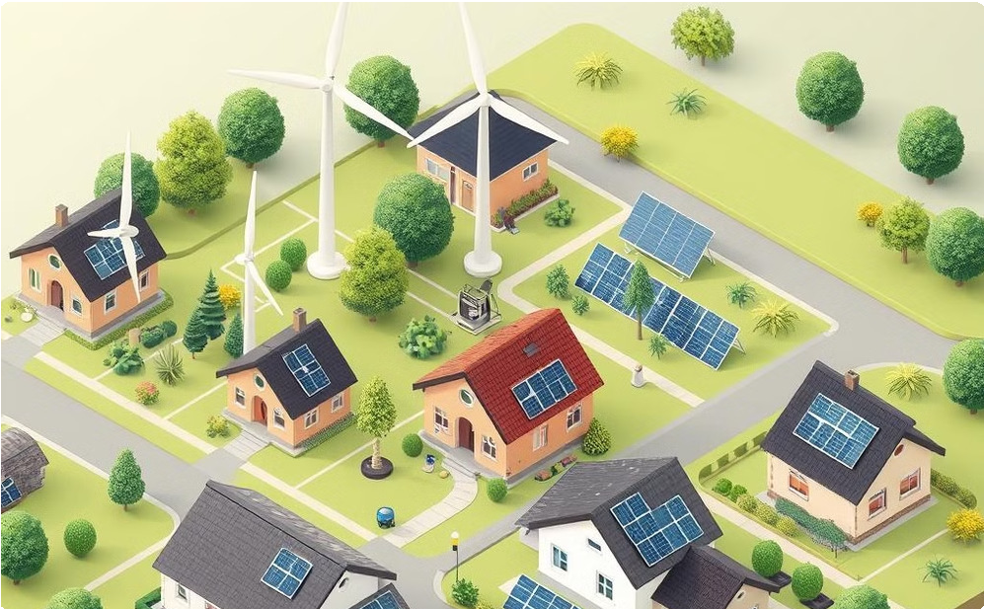


Emerging Technologies: Shaping the Future
Hydrogen Energy
Hydrogen fuel cells offer zero-emission energy solutions for transportation, industry, and power generation.
Microgrid Solutions
Microgrids enhance energy resilience by providing localized, renewable- powered energy systems for communities.
Advanced Energy Storage
Long-duration energy storage technologies, such as pumped hydro and flow batteries, ensure reliable power supply from renewable sources.
Carbon Sequestration
Innovative approaches, such as direct air capture and enhanced weathering, remove CO2 from the atmosphere and store it safely.

Slide 9

Challenges to Climate Tech Adoption
1
Financial Barriers
Upfront costs of climate technologies can be significant, requiring innovative financing mechanisms to accelerate adoption.
2
Policy and Regulatory Hurdles
Harmonized policies, consistent government support, and clear regulations are crucial for fostering a supportive environment for climate tech.
3
Technological Advancements
Continuous research and development are needed to improve efficiency, reduce costs, and overcome technical challenges in climate tech.

Slide 10



Climate Technology: A Path to Sustainability
Collaboration is Key
Governments, industry leaders, and technology companies must work together to accelerate the adoption of climate technologies.
A Sustainable Future
Climate technologies are crucial for building a resilient and sustainable future for generations to come.
Investment Needed
Investing in climate technologies is essential to overcome the climate crisis and build a sustainable future.

Slide 11

Thank you

